Slide 1
Delivery Manager System
Team Name: Colloid
Team Number: 43
Project Supervisor: Mr HJC van Der Westhuizen
Members
Mavuso Mmeli
216016565
Morudu Khanyisile
216090091
Thina Taliwe
216009615

Slide 2
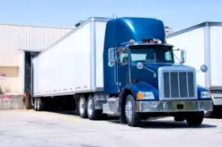
Problem
New Era Commerce
Problem with current system
Assignment allocation
Different truck, different system
DynaFleet for Volvo
CarTrack for other trucks
Start and end time for trips not available
Monitoring of previous deliveries is difficult

Slide 3
Solution Statement: Delivery Manager System
What it is?
Consists of:
Web based system for office personnel
Create deliveries
Assign drivers to deliveries
View start and end time of delivery
Track driver location during delivery
View details of the previous delivery
Mobile application for drivers
Receive delivery information
Start and end trips

